Slide 1
11/16/2022
Quiz 3: Molecular Simulations
Innovation Day
Quantitative Structure-Property Relationships
Solubility Prediction

Slide 2

FALL 2022 INNOVATION DAY
OVERVIEW

Slide 3
At the Kaplan Institute, we understand that practical, technological breakthroughs only come from people who are not just good at technology, but good at leadership: people who understand that influence, inspiration and human insight are as important as engineering and computer science and clean rooms; people who are looking to drive positive change, both in their communities and in the world, and see technology as the means.
The Innovation Day presentation is in effect the final exam for IPRO projects. The presentations demonstrate the entire development process requiring teams to assemble all work done over the course of the semester and present that work to the partners in person.
Innovation Day Overview

Slide 4
In order for us to be able to develop exhibit materials as well as distribute content with our partners, all teams must submit their project deliverables by November 30. The deliverables may include the following:
Innovation Day Deliverables
Presentation Slide Deck
Research Deck and/ or Written Report
Supporting Media/ Documentation
(Poster, Videos/ Animations/ Renderings/ Documentation of Prototypes)
Please submit all relevant project materials using the following the link below:
Team Submission
Innovation Day Project Submission

Slide 5
Innovation Day: Friday, Dec. 2nd
8:00 - 9:00 AM
Team setup
9:30 - 12:30 PM
Doors open/ Judging begins
12:30 - 1:30 PM
Judges’ deliberation & lunch
1:30 PM -2:00 PM
Recognition ceremony
Innovation Day Schedule

Slide 6
Sustainable Cities
Community and Social Innovation
Sports and Technology
Competitions
Research
Innovation Day Judging Tracks

Slide 7

COMMITMENT TO POSITIVE COMMUNITY CHANGE | Did the team identify and analyze a contemporary issue and problem? Did the team address and compare different perspectives, both within and across cultures?
CRITICAL AND INNOVATIVE THINKING | Did the team appropriately employ multiple quantitative and qualitative methods of analysis and evaluation? Did the team employ the best available technology to achieve the solution(s)?
PROFESSIONAL AND ETHICAL COLLABORATIONS | Did the team members successfully work with others within disciplines and cultures? Did the team identify and discuss ethical issues?
EFFECTIVE COMMUNICATION | Did the team speak and write appropriately within and across disciplines and cultures? Did the students present their project in clear, concise, and logical form both verbally and through visual/graphic supporting material? Did the team clearly establish an objective and cohesively support it?
Judging Rubric
Click here for the evaluation form

Slide 8

Each team will have approximately 2’ x 3’ of table space with access to power.
Your team needs to be able to stand out. Build prototypes!!!
Bring your own displays (computer monitors or televisions) for more visuals.
Please have your students fill out this form for special requests regarding equipment/space needs.
Exhibition Space

Slide 9
Design all graphics for 24” x 36” layout. Do NOT scale up from a smaller page size
Use no less than 24pt font
Print a black and white full size version to mockup, then adjust image sizes and fonts as needed
Check all spelling BEFORE you print
Send files to the Post Office Mail Center at MTCC
Poster Guidelines & Best Practices

Slide 10
The IPRO office is offering vouchers for teams to print 24” x 36” posters that can be mounted to foam core.
Please visit the Kaplan Welcome Desk or the IPRO Help Desk for a voucher to print your poster at the MTCC Post Office (2 vouchers/team).
Vouchers will become available from November 9th onwards.
Foam core will be available at the Idea Shop from the week of November 14th.
Poster Printing

Slide 11
Event
Deadlines
& Requests
Teams should fill out this request form by Friday, November 25 for any special requests for Innovation Day. We cannot honor any requests made after that date.
Teams are required to submit their project deliverables by Wednesday November 30th here.
Teams must have their project space set up by 9 AM on Friday, December 2nd.

Slide 12
Make A Plan
Envision the experience you wish to deliver, what is the sequence of movements, and set goals for that.
Visualize
Imagine the exhibition space, then sketch out how you plan to set up your table. How will you display your visuals, prototypes etc.
Practice
What is the story you want to tell, how do you want the audience to feel and react. Presentations need to be 3-5 minutes.
Work With Your Professors
Professors can help determine ways to best portray your work
Divide & Conquer
Everyone on the team needs to contribute, work to each others strengths.
Prepping For
Innovation Day

Slide 13
Video & media is a great medium to tell your story and illicit emotion
Remember audio will be hard to hear on Innovation Day
Videos & animations can effectively demonstrate functions of your concept
*Videos/ Media is not required for Innovation Day
Using Video & Multimedia

Slide 14
Resources

Slide 15
IPRO Office Resources
Supplies and Purchasing
https://ideashop.iit.edu/portal/
https://ipro.iit.edu/class-resources/
Software on Campus
https://ots.iit.edu/classrooms-labs/lab-software
https://wiki.ideashop.iit.edu/index.php?title=Computer_Software

Slide 16
Visual Assets
Icons
● The Noun Project: https://thenounproject.com
● Font Awesome: https://fontawesome.com/icons?d=gallery
● Dryicons: http://dryicons.com/free-icons/
● FREEBIESBUG: http://freebiesbug.com/psd-freebies/icons/
Free Imagery - Photography
● UNSPLASH: https://unsplash.com
● PixaBay: https://pixabay.com
● Free Images: http://www.freeimages.com
● PEXELS: https://www.pexels.com
● PICJUMBO: https://picjumbo.com
● PixaBay: https://pixabay.com

Slide 17
Visual Assets
Video Clips (Free - select ones on sites)
● https://www.wedistill.io/
● https://coverr.co/
● https://www.pexels.com/
● https://pixabay.com/
● https://www.videvo.net/
● https://www.videezy.com/
● https://www.vidsplay.com/
● https://mazwai.com/
More generic, aerial & drone shots:
● https://www.lifeofvids.com/
● https://dareful.com/
● https://www.splitshire.com/

Slide 18
Interaction Design Tools
Figma: https://www.figma.com/
Figma for beginners: https://www.youtube.com/watch?v=Saz6S1svYns
Sketch: https://www.sketch.com/
A guide to sketch basic: https://www.youtube.com/watch?v=qywB0JHQeC4
Mockplus: https://www.mockplus.com/
Mockplus Tutorial: https://www.youtube.com/watch?v=LGZDZ-L0ejo
Adobe XD (can use from Idea Shop at Kaplan: Ideashop Link)
Top ten things to know when getting started with Adobe XD: https://www.youtube.com/watch?v=JttI6YpmPGI

Slide 19
Examples for Innovation Day

Slide 20
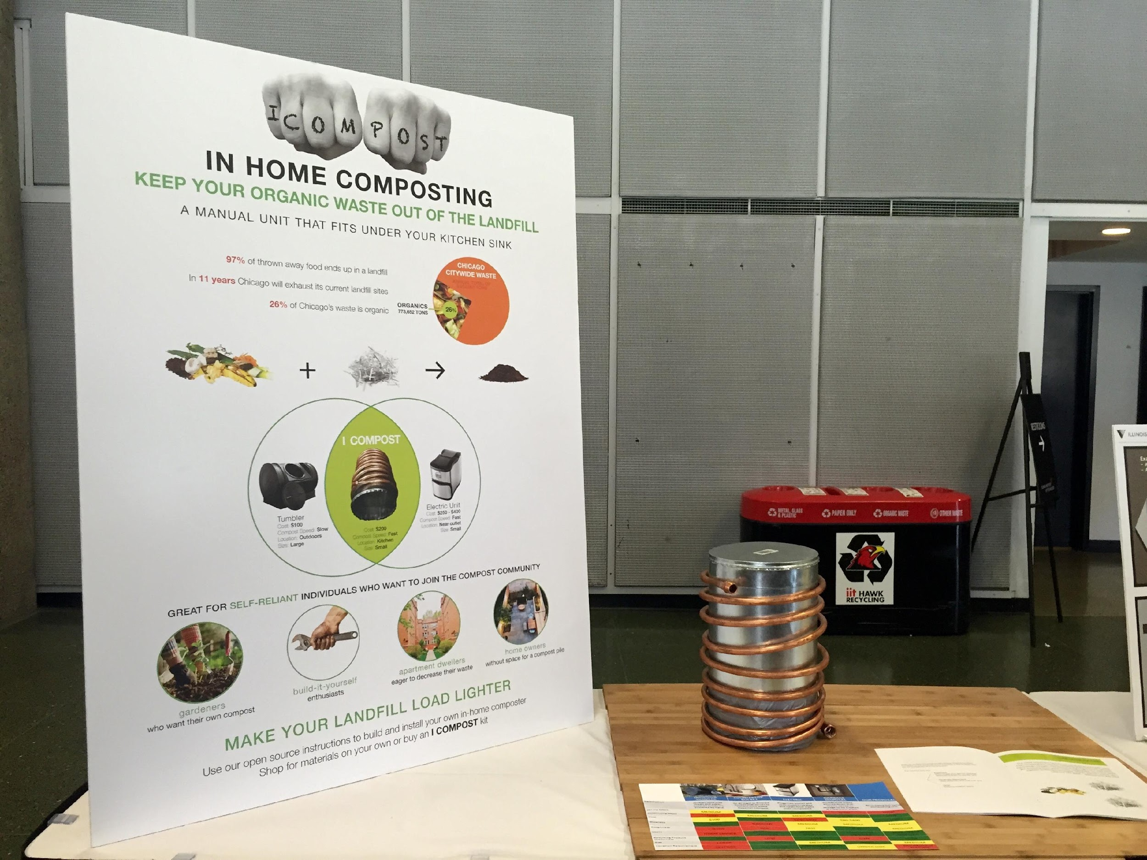

Slide 21
What is it? & Concisely states problem
Strategy
(this team included cost here bc it was DIY)
Support problem
Who? & benefits
Why ?
How?

Slide 22
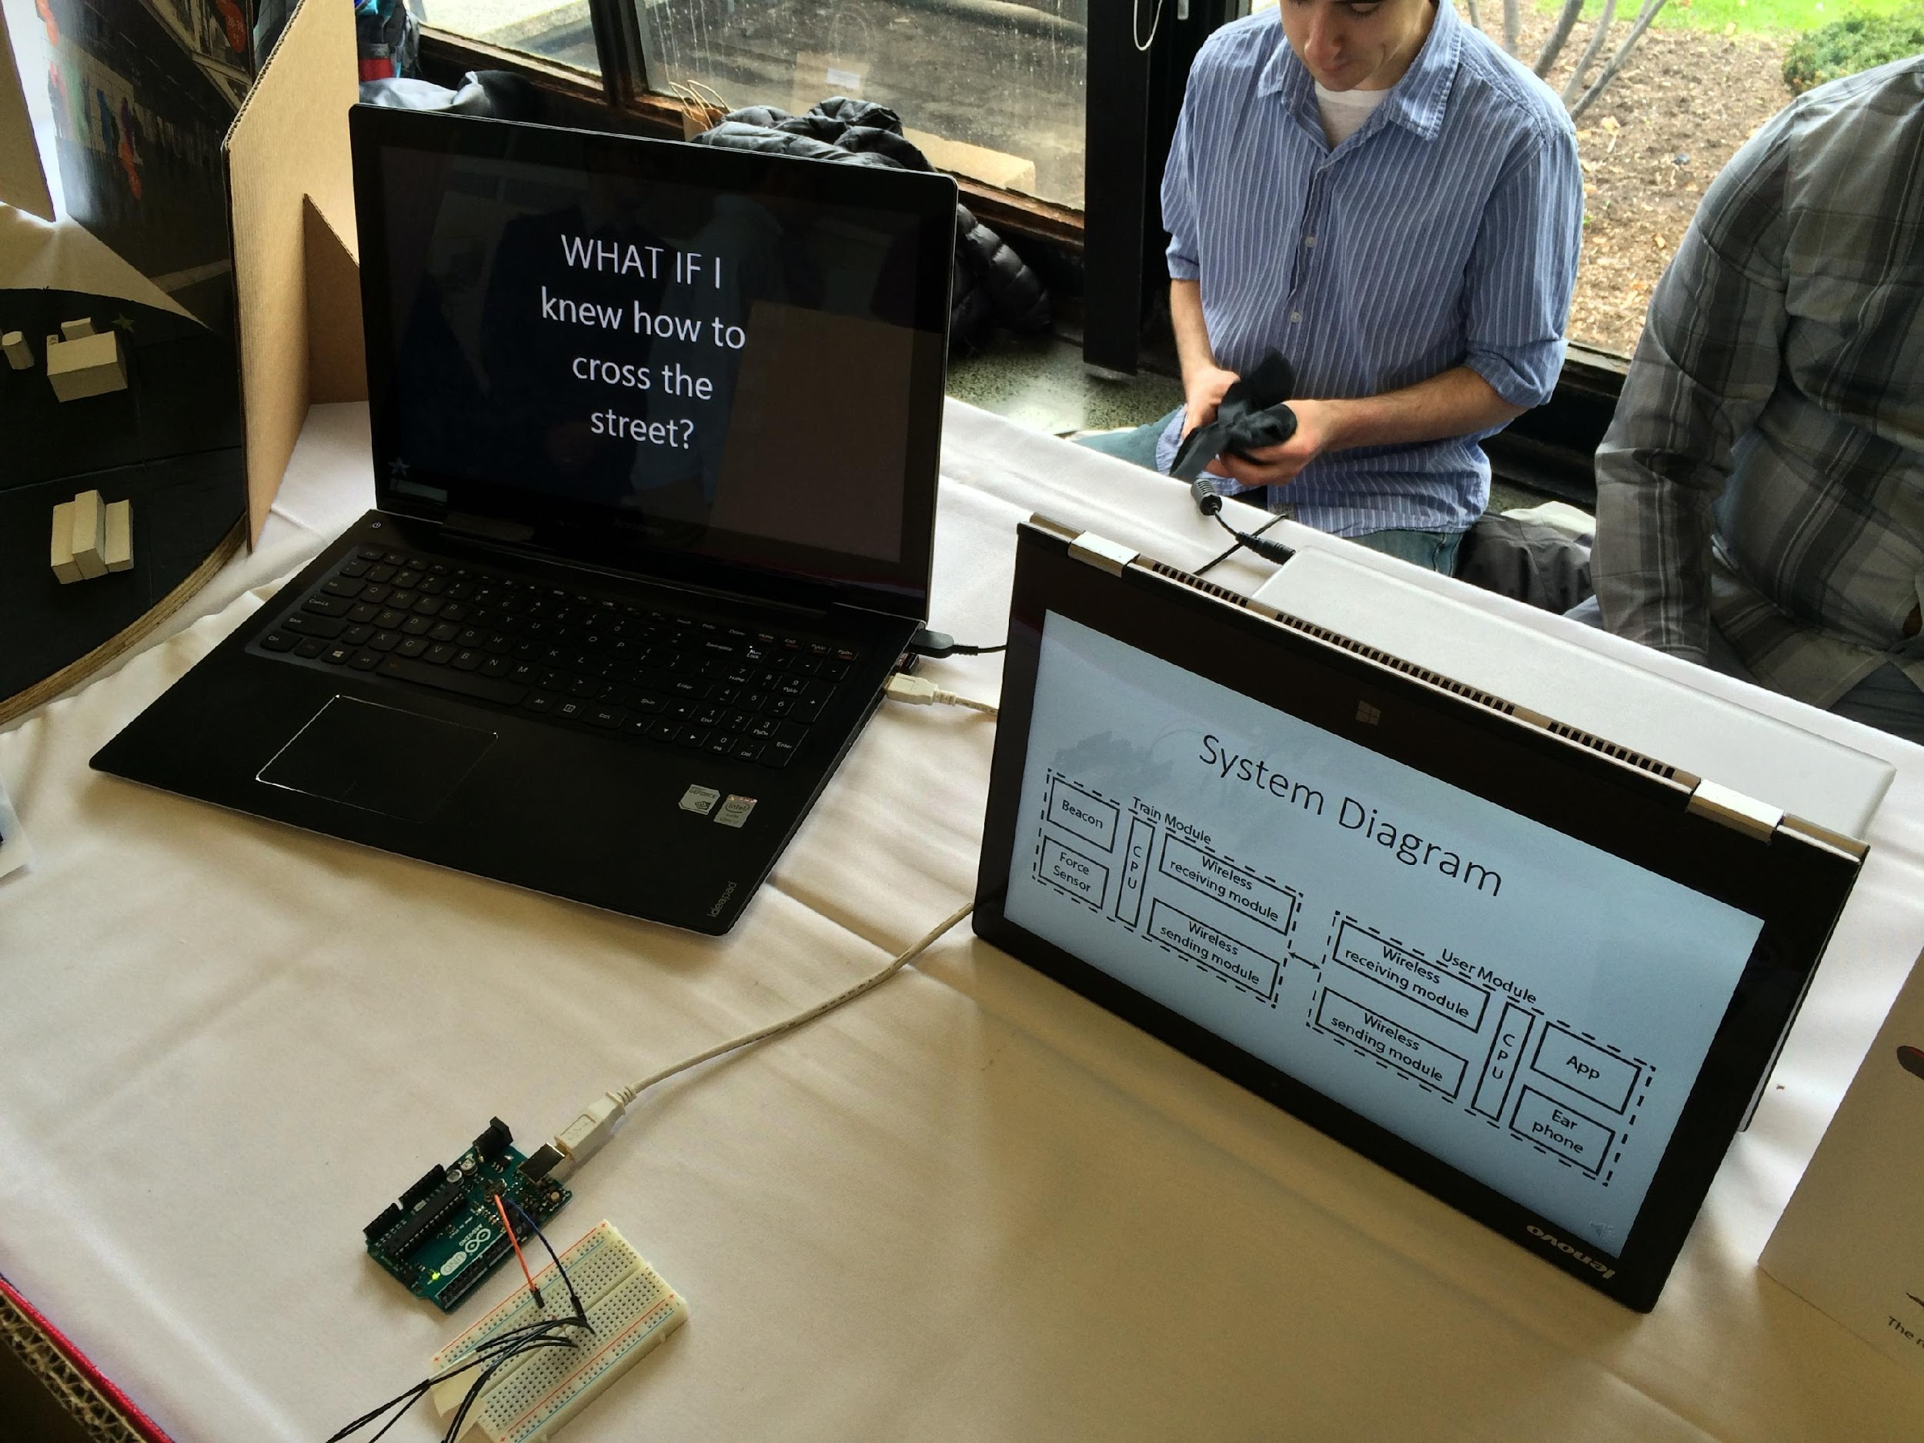

Slide 23
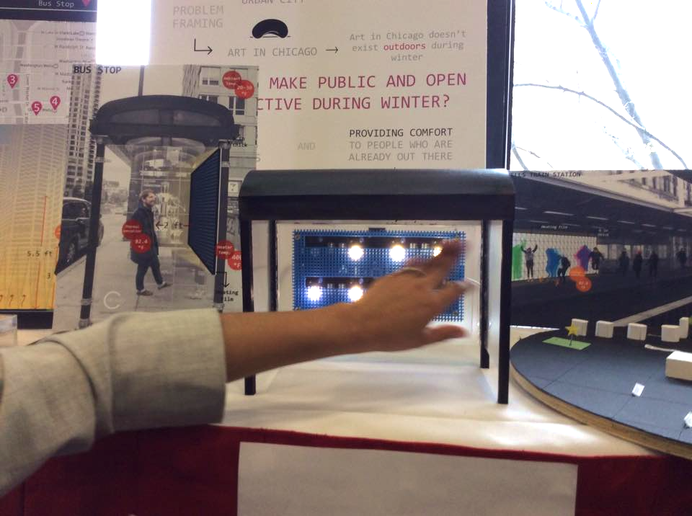

Slide 24
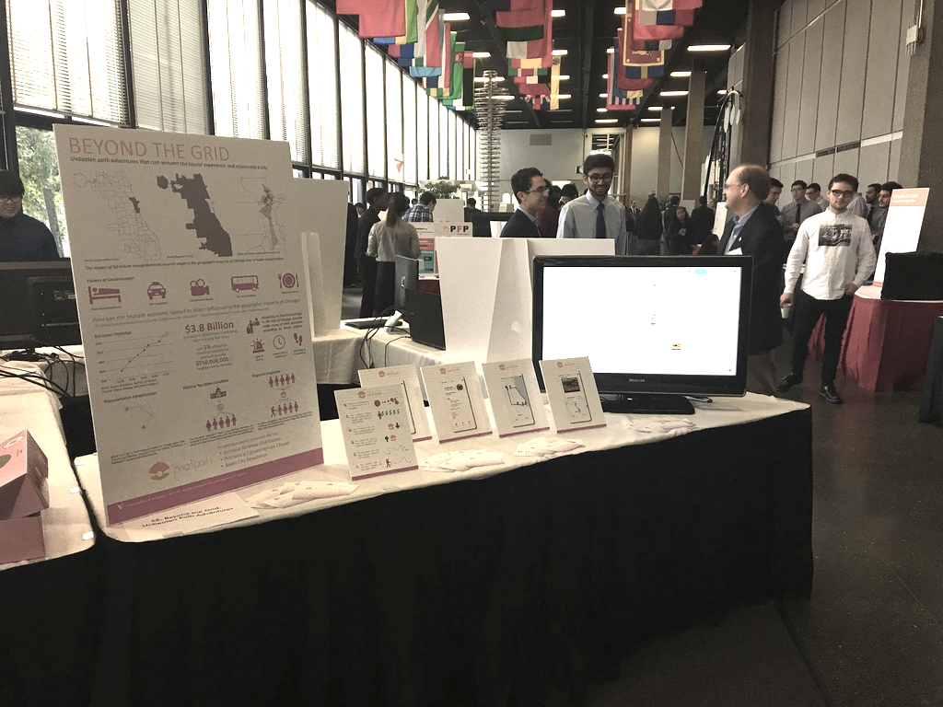

Slide 25
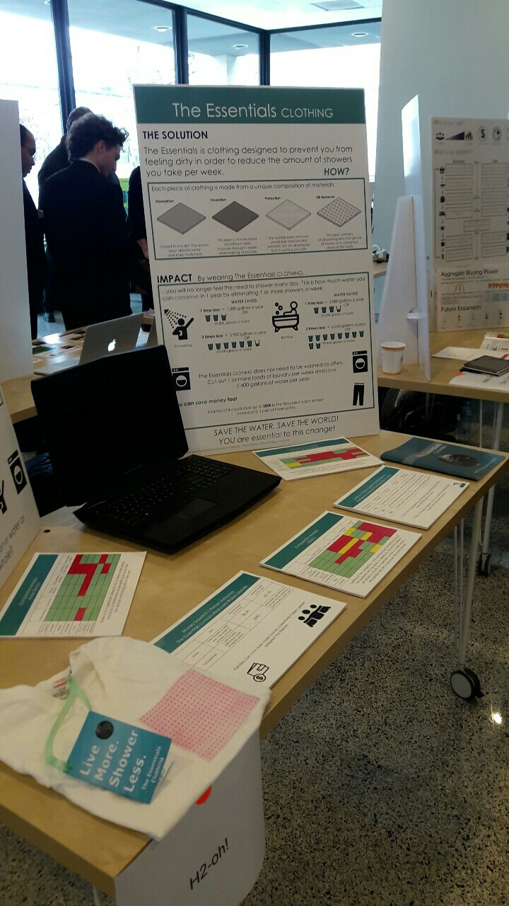
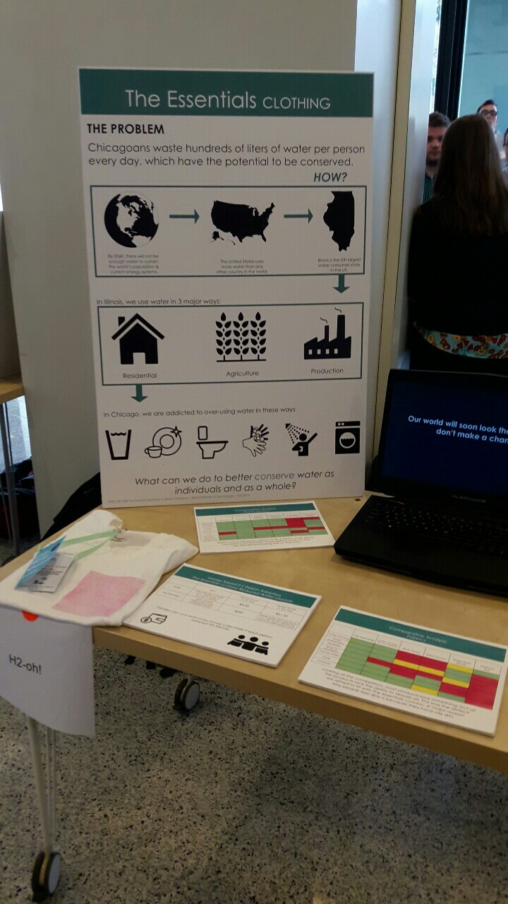

Slide 26
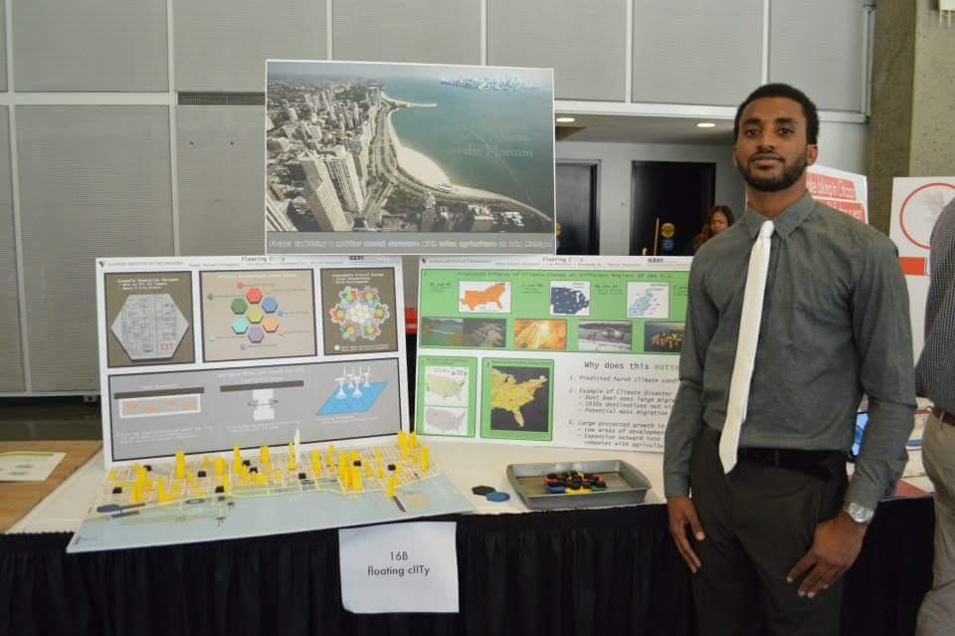

Slide 27
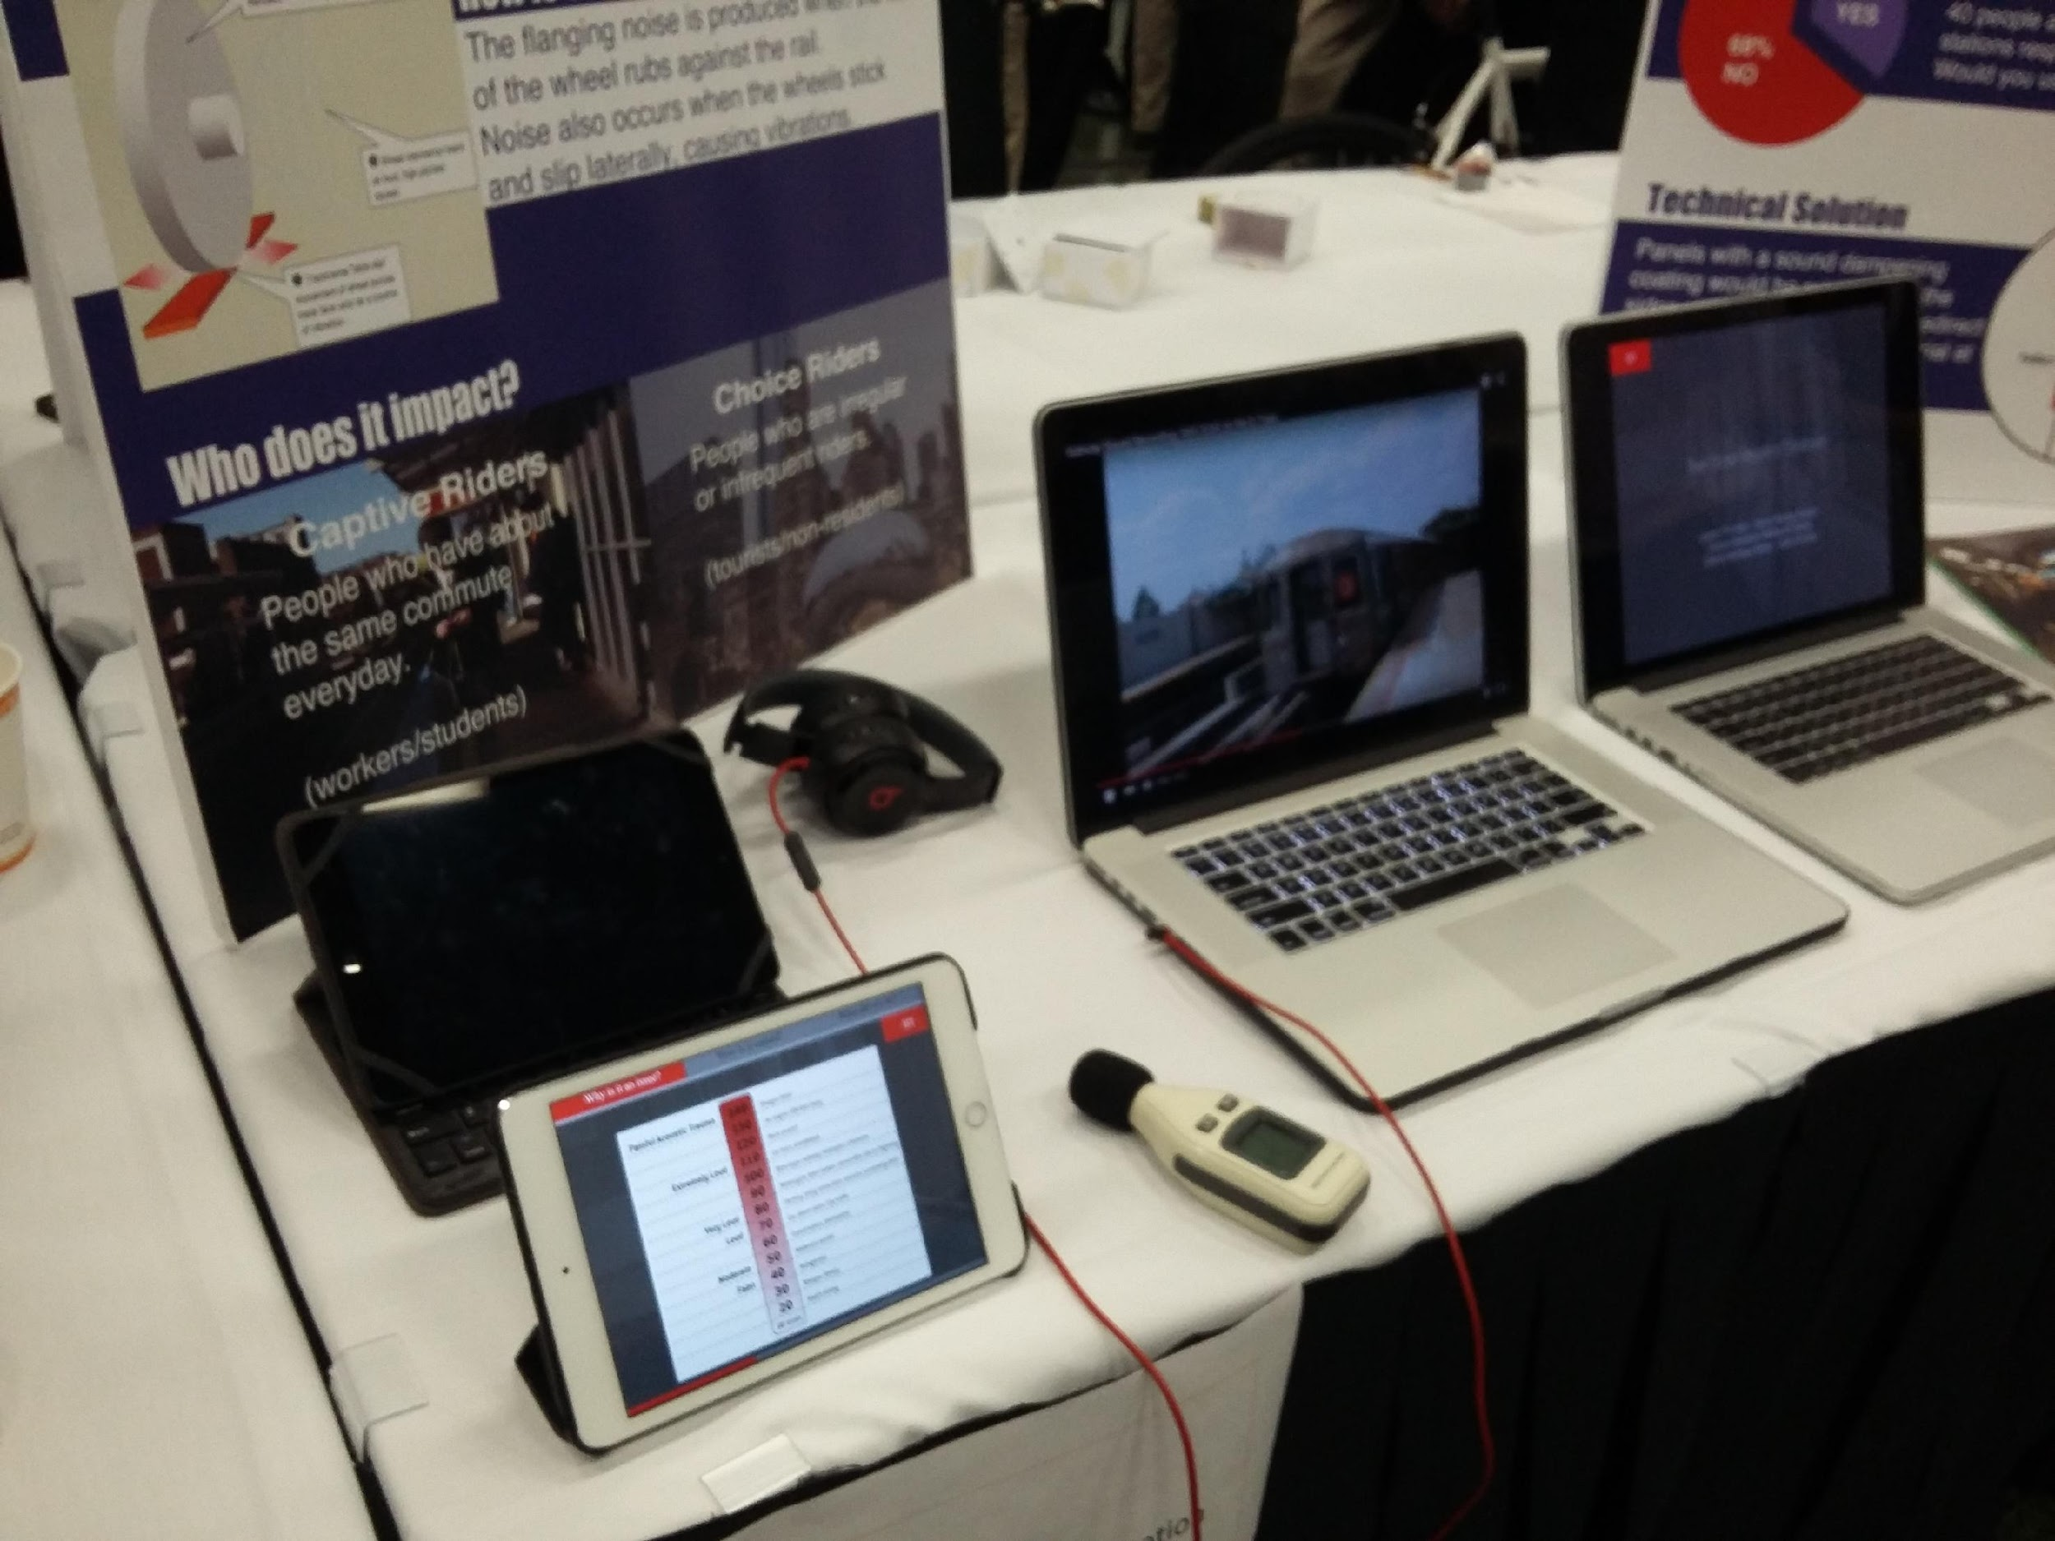

Slide 28
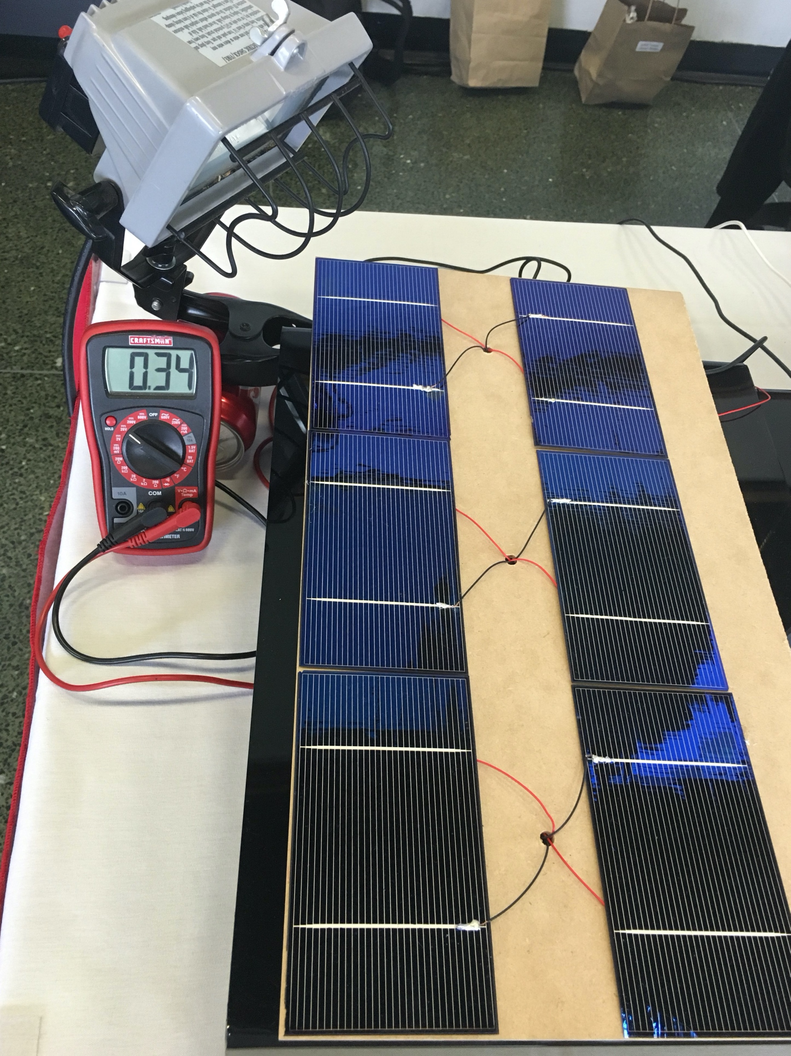
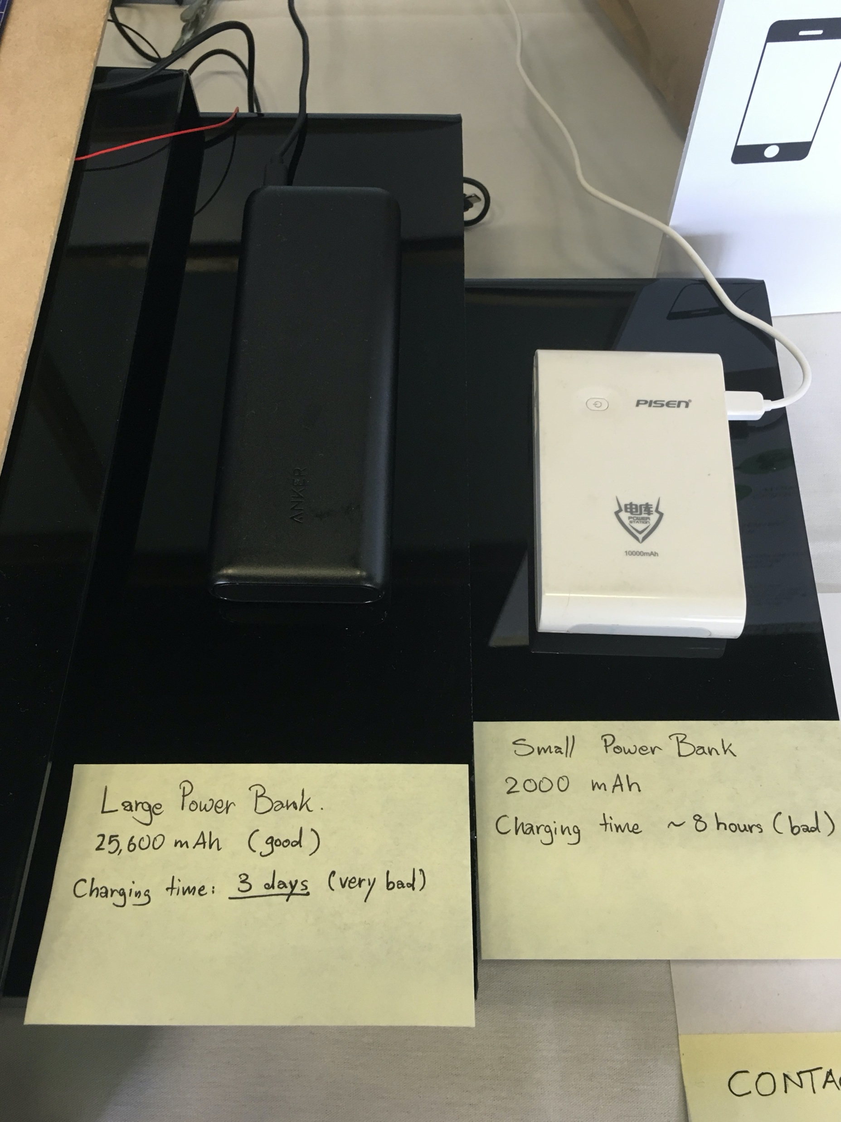

Slide 29
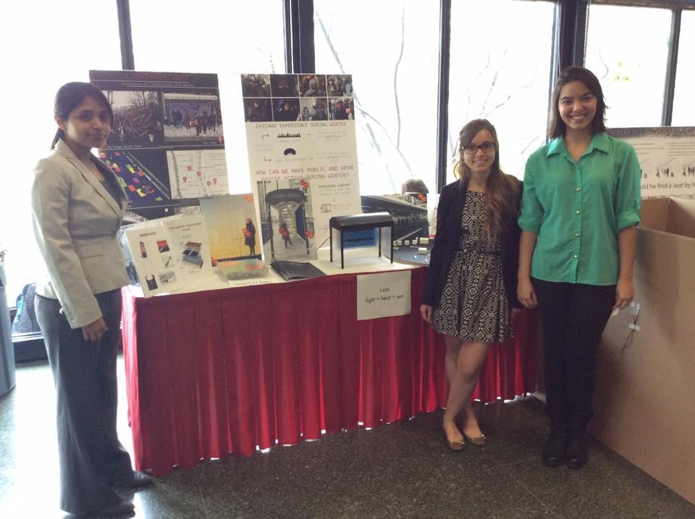

Slide 30
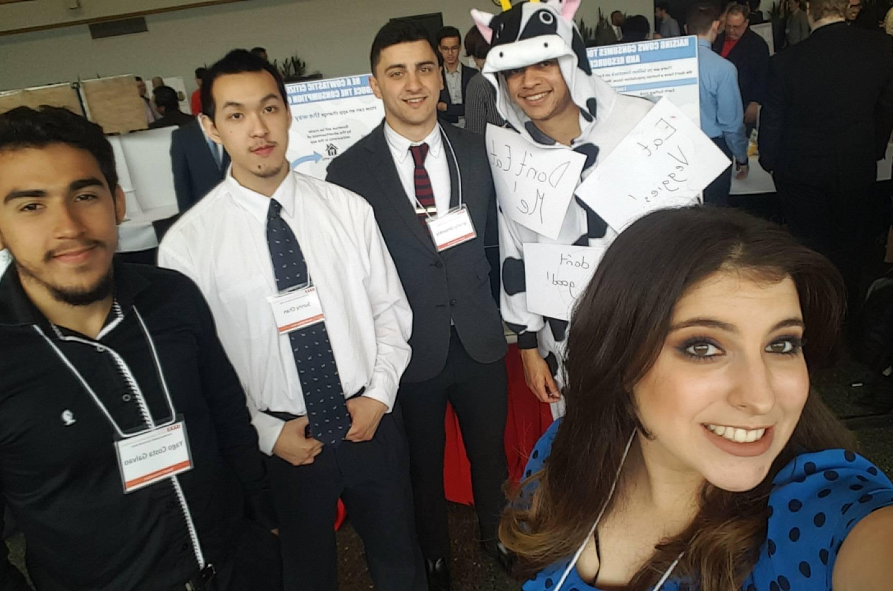
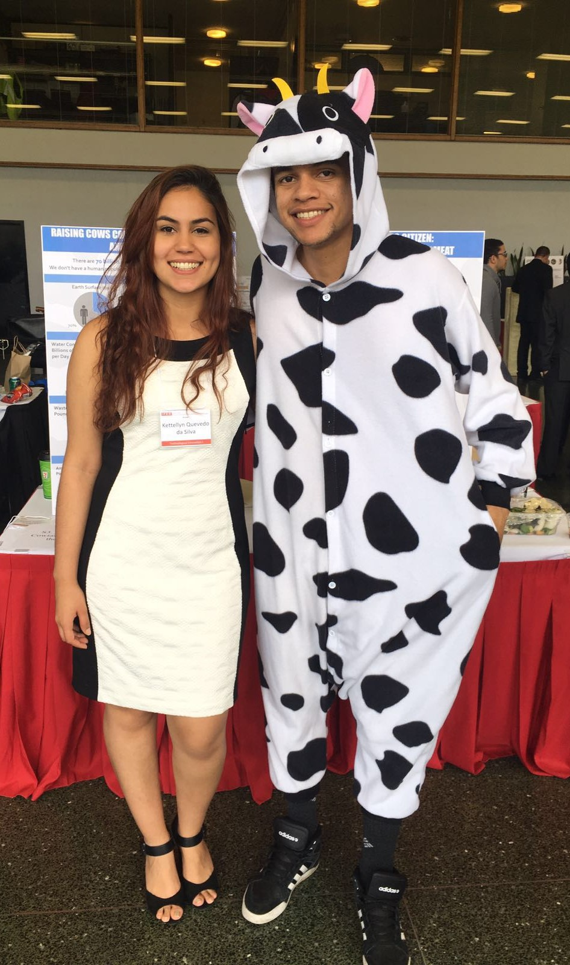

Slide 31
Quantitative Structure-Property Relationships
Today’s lecture is intended to help you achieve the following learning objective: Develop a model for a quantitative structure-property relationship. Describe its domain of applicability.
QSPR Topics
Machine learning
Features/descriptors
Algorithms
Validation
Limitations

Slide 32
QSPR is an application of machine learning
Machine learning [1]
“gives computers the ability to learn without being explicitly programmed” - Arthur Samuel (1959)
“A computer program is said to learn from experience E with respect to some task T and some performance measure P, if its performance on T, as measured by P, improves with experience E.” -Tom Mitchell (1997)
In Quantitive Structure-Property Relationships (QSPR)
Experience E: chemicals
Task T: predicting physical property, e.g.
boiling point, chromatography retention times
activity against a biological target = QSAR
ADMET (absorption, distribution, metabolism, and excretion - toxicity)
Performance P: correlation/error in validation set/real-world applications

Slide 33
Features/Descriptors
Enables chemicals to be input into machine learning models
How would you describe a chemical in numbers that can be put into a mathematical formula?
Features can be
from enumerable properties, e.g. number of a certain element, number of H bond donors/acceptors, presence/absence of an element functional group
based on 3D structures
of a chemical, e.g. surface area, radius of gyration, moments of inertia
of a protein-ligand complex
http://www.rdkit.org/docs/GettingStartedInPython.html#list-of-available-descriptors

Slide 34
Algorithms
Linear regression
y = mx + b for simple linear regression
y = m1x1 + m2x2 + … + b for multiple linear regression
x is projected onto a new space in partial least squares regression
Neural networks
sets of nodes that transform inputs into an output
allows for nonlinear relationships.
Deep learning
neural networks with multiple layers
increasingly popular and powerful with faster computers and larger datasets
Not an exhaustive list!
Diagram of an artificial neural network [2]

Slide 35
Validation
How do you know if a model is any good?
Data are split into training and test sets
Both sets should represent the same population
Model is built using the training set
Calculations on test set are compared to data

Slide 36
Limitations
What do you think some limitations of QSPR might be?
A high-quality training set is necessary
Models can only be applied to molecules similar to the training set
Sometimes small changes in structure can lead to large changes in a property
adding a methyl can make it so that a ligand no longer fits into a binding pocket
in QSAR, known as an “activity cliff”

Slide 37
References
[1] https://www.geeksforgeeks.org/introduction-machine-learning/
[2] Downloaded from https://commons.wikimedia.org/wiki/File:Colored_neural_network.svg and reused under the CC BY-SA 3.0 license

Slide 38
Solubility Prediction
The importance of solubility prediction
The Solubility Challenge (2008)
QSPR prediction of solubility
Free energy calculations of solubility

Slide 39
The importance of solubility prediction

Slide 40
Why predict solubility? [2]
Drug candidates should have sufficient solubility to be
tested in biological assays
stored
bioavailable
Rules of thumb are unreliable

Slide 41
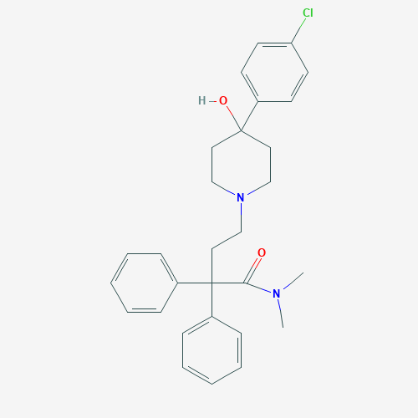
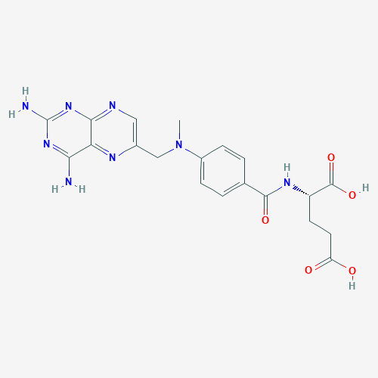
Poor solubility is a major problem [2]
Pharmacokinetics
Up to 40% of drug discovery programs abandoned due to pharmacokinetics - the movement of drugs within the body
Low solubility is associated with problems with pharmacokinetics
Precipitation
Loperamide (diarrhea drug) can sometimes precipitate when injected
Methotrexate (cancer drug) has kidney toxicity due to precipitation
Polymorphs can affect solubility and have different bioavailability, e.g. ritonavir (HIV drug) had to be reformulated
Loperamide
Methotrexate

Slide 42
Polymorphs are chemical engineering problem
Chemical structure and SEM images from [4]
LAB687 (lower triglyceridess and LDL cholesterol)
Early on, observed form A and B
Later, found form C
Form D observed in scale up, and began to predominate!

Slide 43
Why work with low-solubility compounds?
Practical reason
increased weight and lipophilicity of test compounds from high-throughput synthesis and screening
Principled reasons
drugs usually need to permeate cell membranes
increased binding affinity - the molecule prefers the complex over the solvent - often associated with reduced solubility

Slide 44
How are solubility problems hidden?
use of solvents, e.g. DMSO, in early-stage assays
pH dependence
free acid/free base is less soluble than salt
intrinsic solubility is solubility of free acid/free base
kinetic solubility - appearance or disappearance of precipitate at different concentrations than the thermodynamic saturating concentration (sub- or supersaturation)
polymorphs not always known
These problems are also reasons why solubility is difficult to measure and predict

Slide 45
The Solubility Challenge

Slide 46
Solubility Challenge (2008) [2, 3]
measured
intrinsic solubility (free acid/free base)
highly reproducible (thermodynamic versus kinetic solubility)
published 100 solubilities
challenged researchers to predict 32 more
received >100 entries between July and September 2008

Slide 47
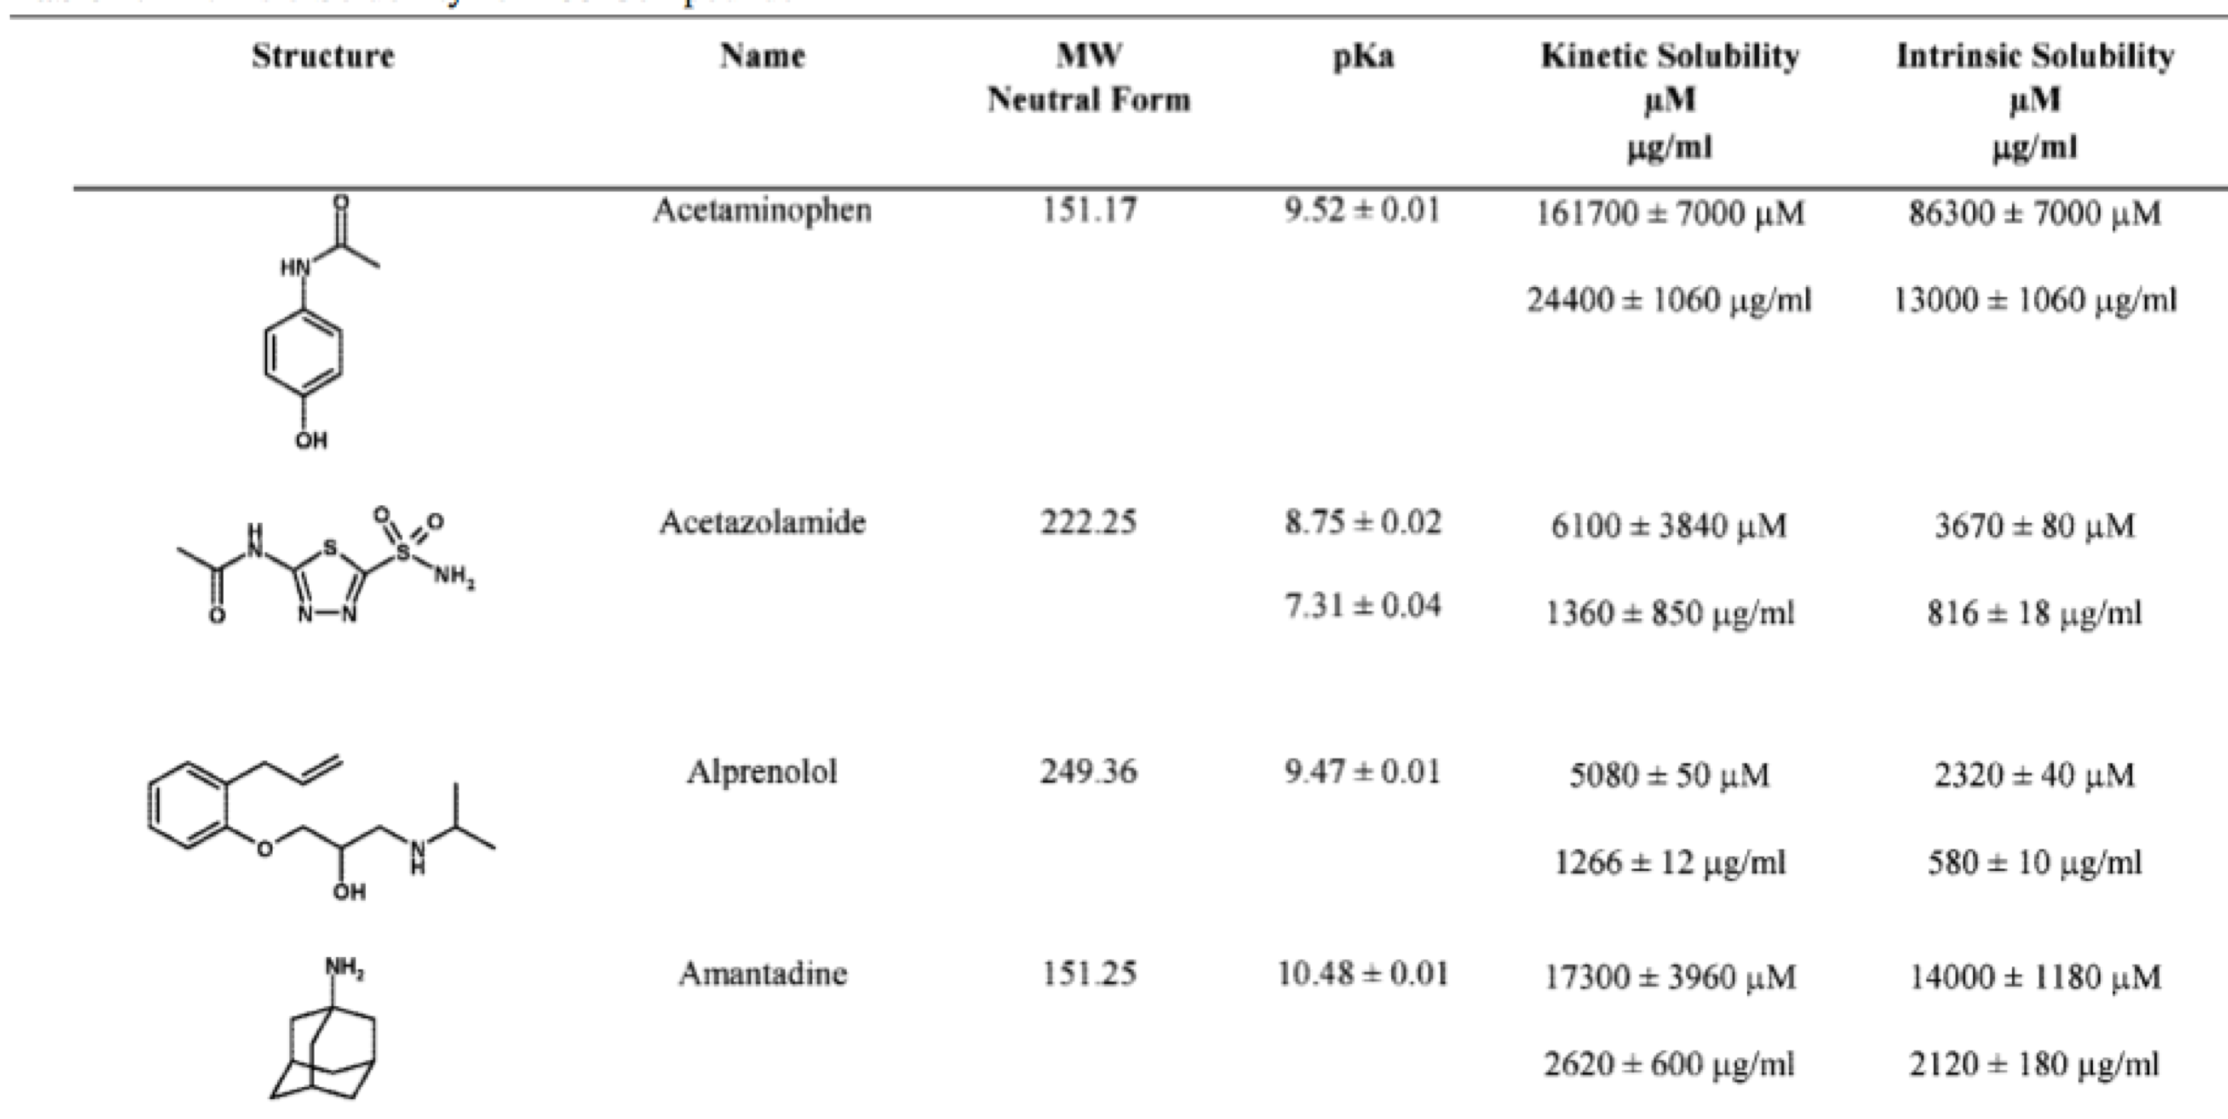
Examples from the dataset [2]

Slide 48
Overall performance in the solubility challenge
Figure 2 from ref [3]
“Correct” is within 0.5 logS
Blue bars are percentage correct
Red is actual logS

Slide 49
Stated major findings [3]
For measured set of 28 compounds, percent correct on
absolute S (±10%) ranges from 0%-18%
logS (±0.5 logS) ranges from 10-61%
Worst two compounds 2% and 4% correct by logS
R² ranges from 0 to 0.65
No polymorph predictions
Compounds with “normal” solubility (logS = 0.5 to 3) were easiest
Many methods, but none clearly the best

Slide 50
QSPR prediction of solubility

Slide 51
Historically informative descriptors [5]
Molecular size or surface area - cost of forming cavity in water
Octanol:water partition coefficient (P) - solubility relative to a non polar phase
Melting point - higher means more stable solid
Hydrogen bonding - favors water solubility
Atom/group contributions
Molecular connectivities

Slide 52
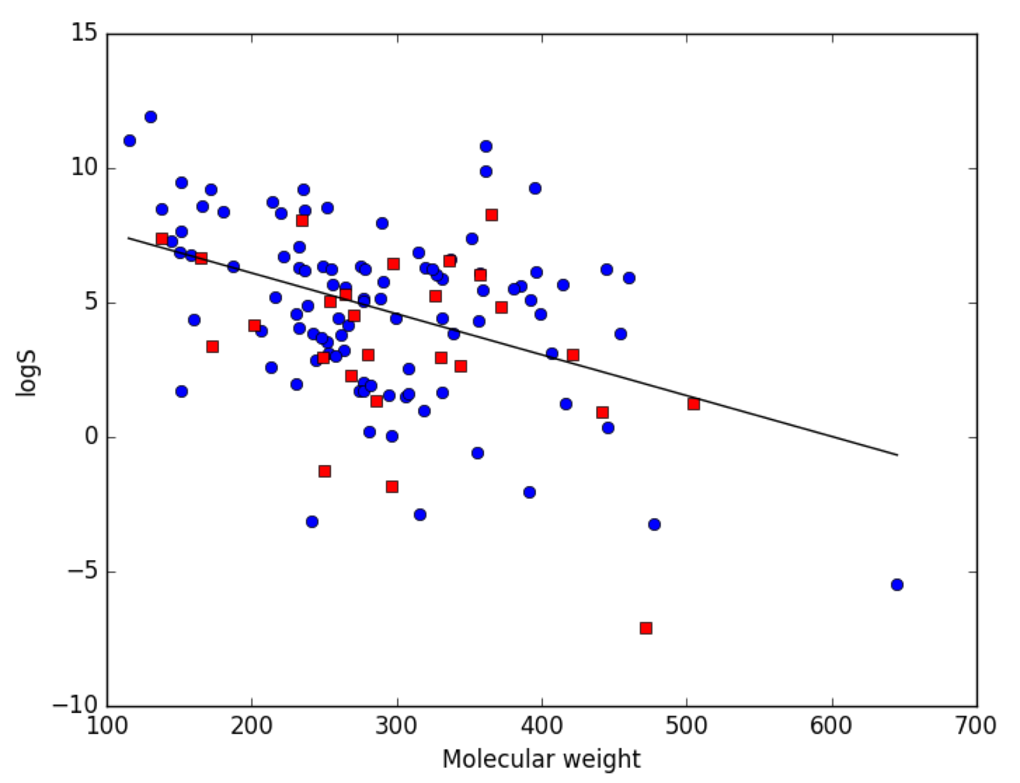
Molecular weight has some predictive power
From Ref [1]
Blue: training
Red: test
Black: predictions

Slide 53
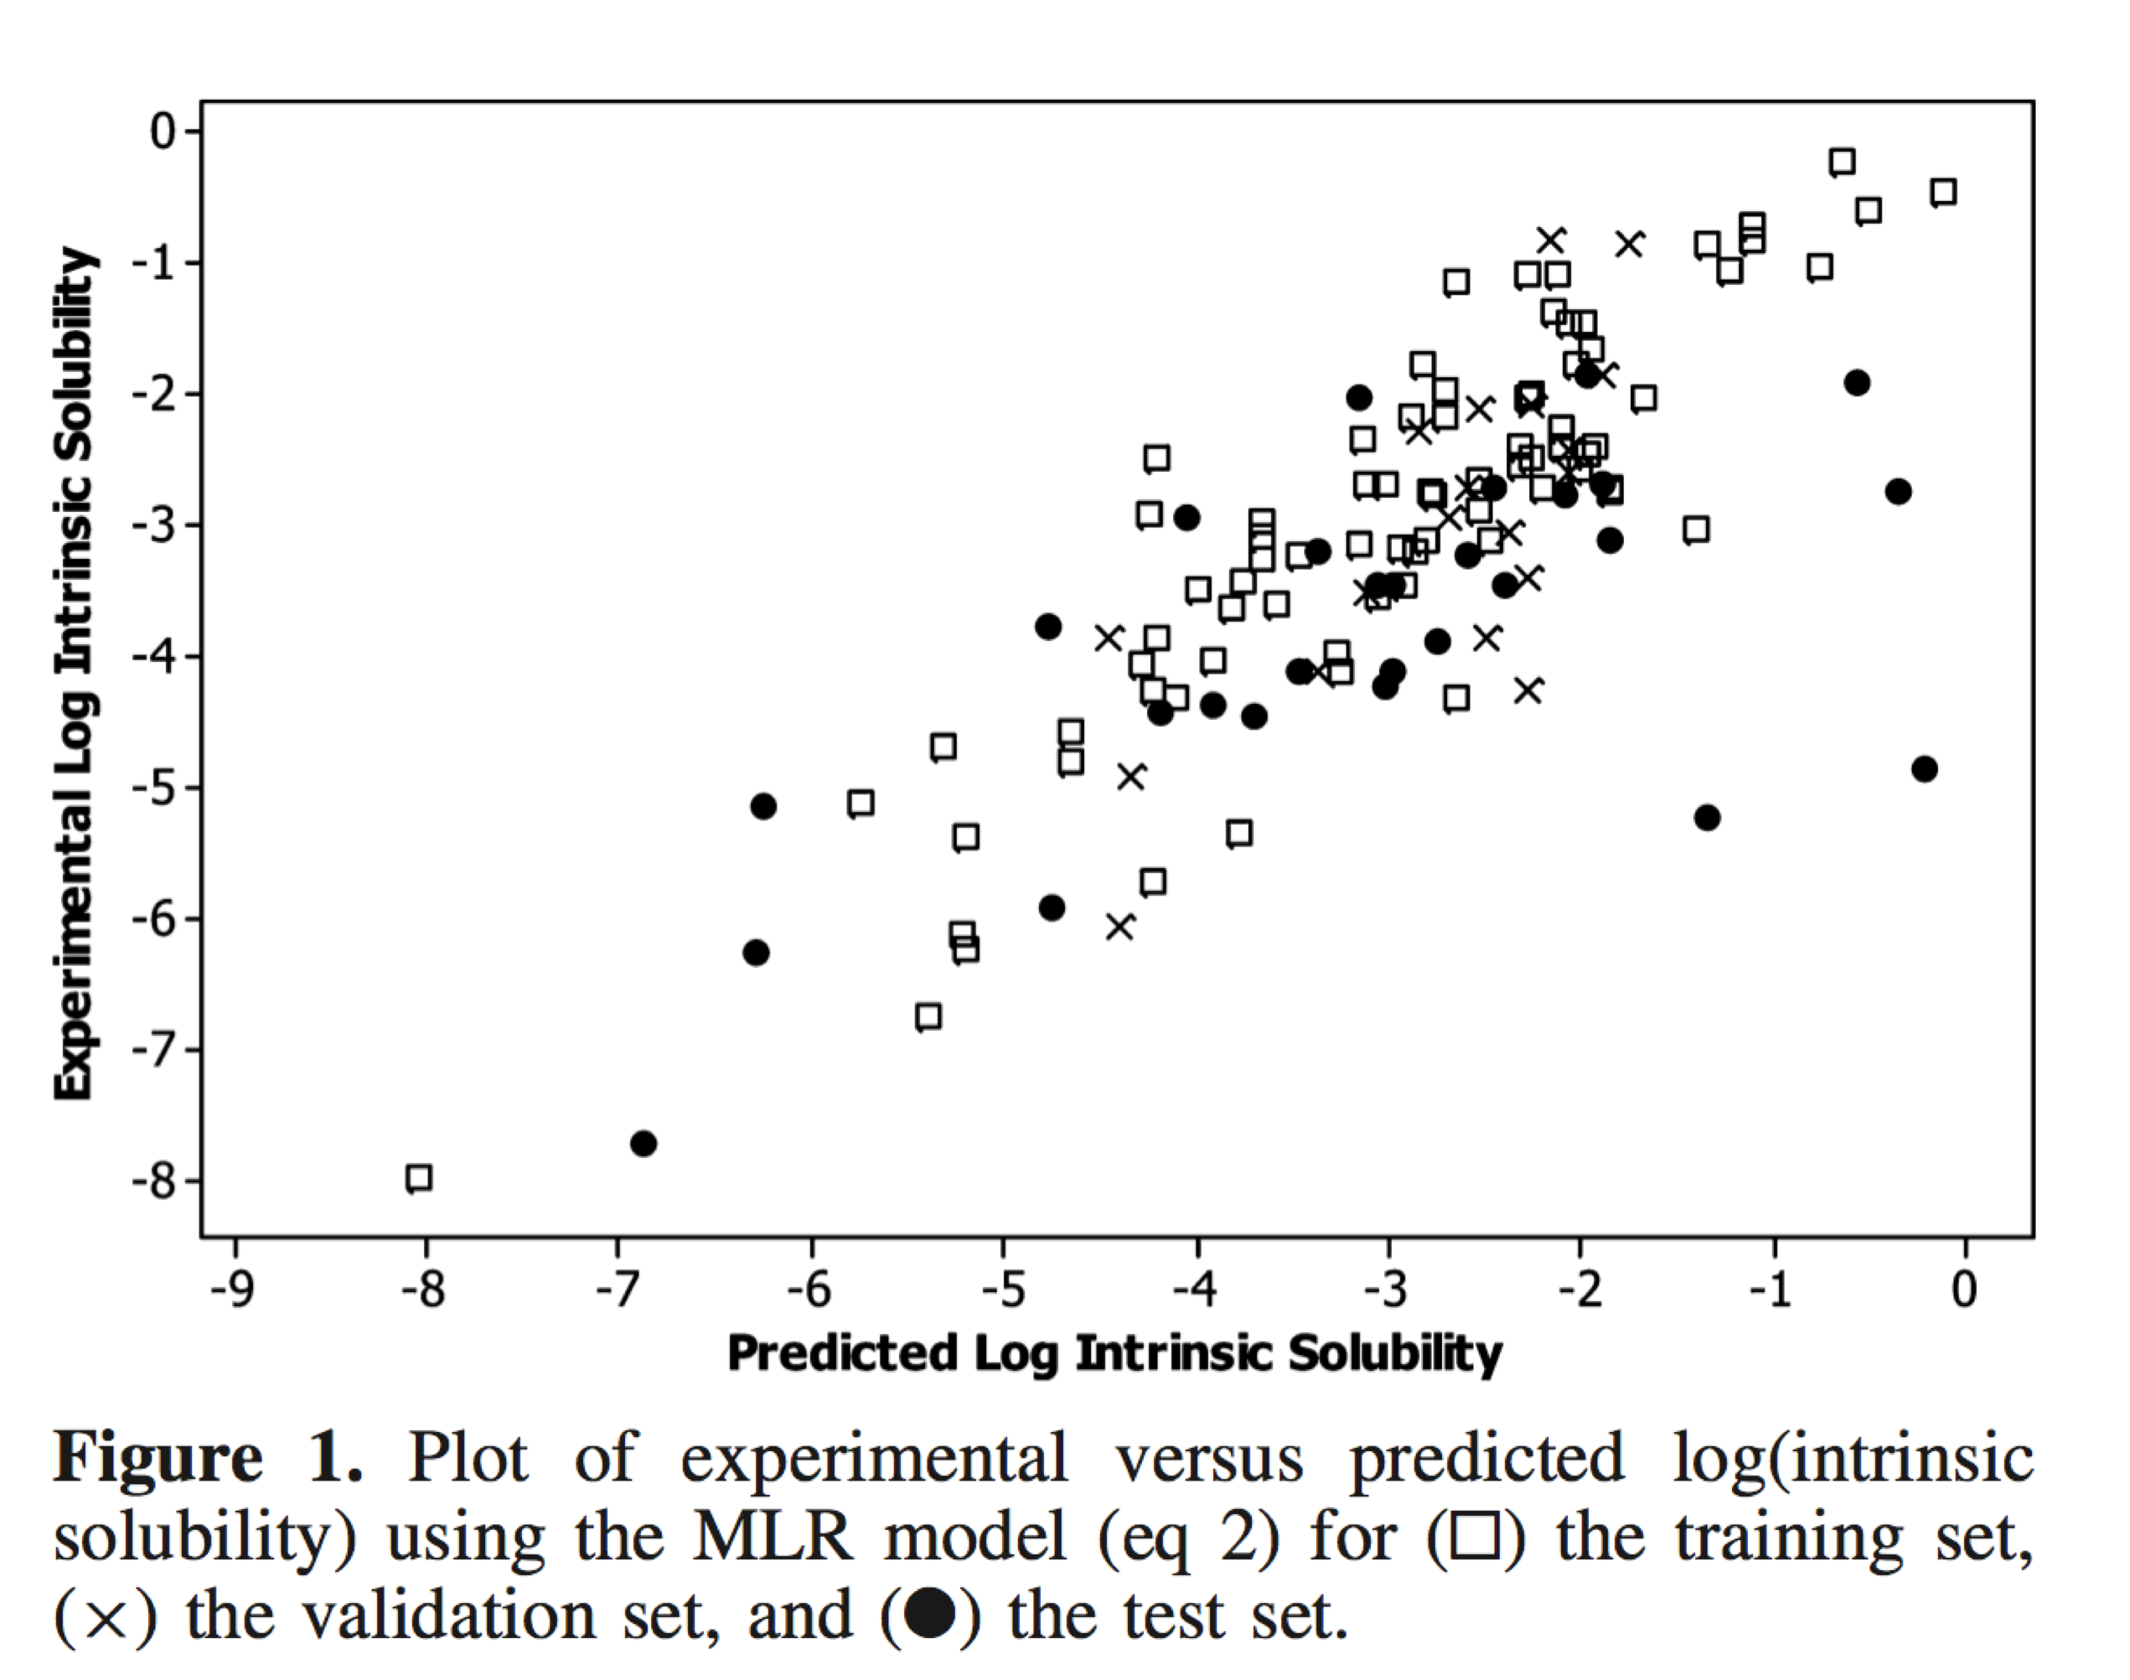
QSPR in the solubility challenge
Hewitt et al tried four QSPR models [5]
Multiple linear regression (426 descriptors, genetic algorithm, no more than 5 used at once)
Artificial neural network
Category-specific models based on H bond ability
Various commercial QSPR models
Consensus, mean of four models
The best was a three-descriptor linear regression
based on log P, boiling point, and R maximal autocorrelation of lag 2 (related to size and connectivity).
$R_{train}^{2}=0.74$, $R_{test}^{2}=0.51$
“none of the other modeling approaches used in this study was able to improve upon the predictions made by the MLR model”

Slide 54
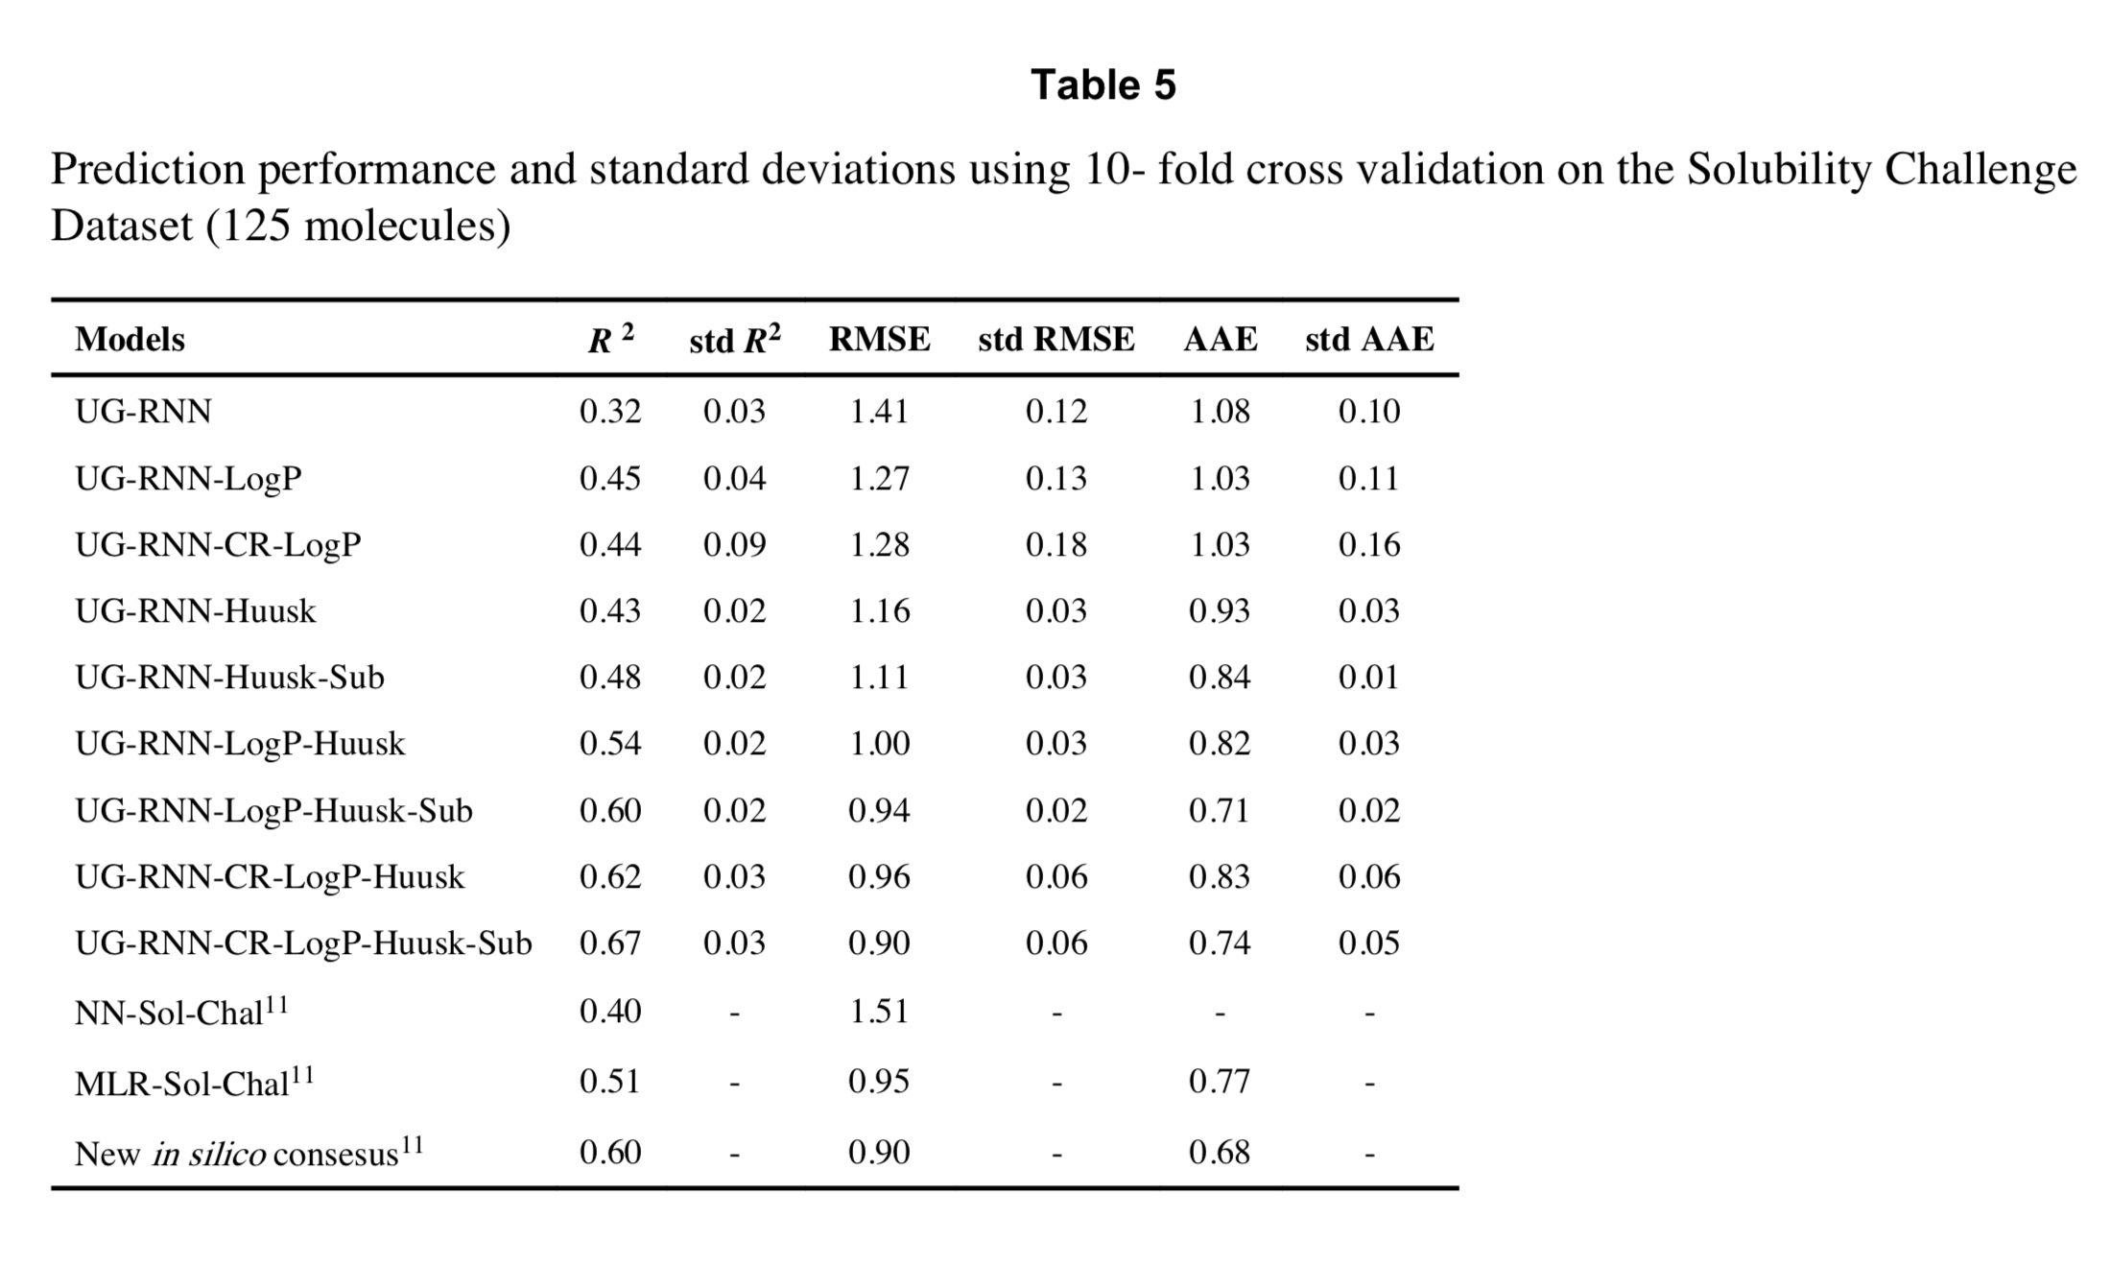
Can deep learning do better? [6]
Better than simple neural network, but worse than MLR
Huusk results are based on more data.
Sub results use different solubility values.
In summary, deep learning can do better if there is more data.

Slide 55
Opening the black box?
Recent deep learning method seems to perform well in solubility prediction and
also highlights moieties that contribute to (red) or detract from (blue) solubility. See Ref. [7].

Slide 56
Free energy calculations of solubility

Slide 57
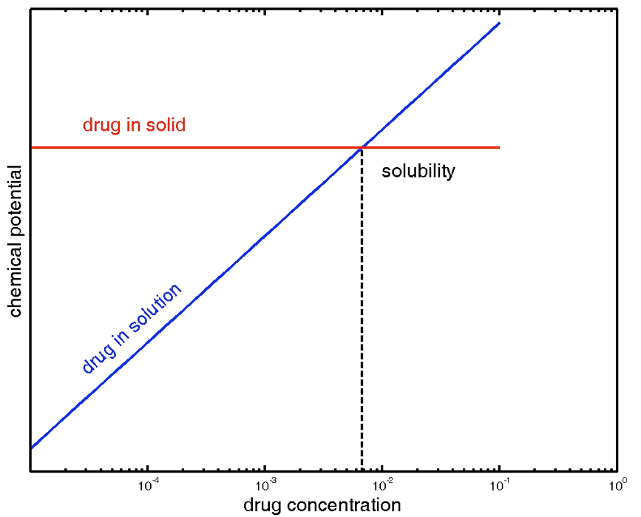
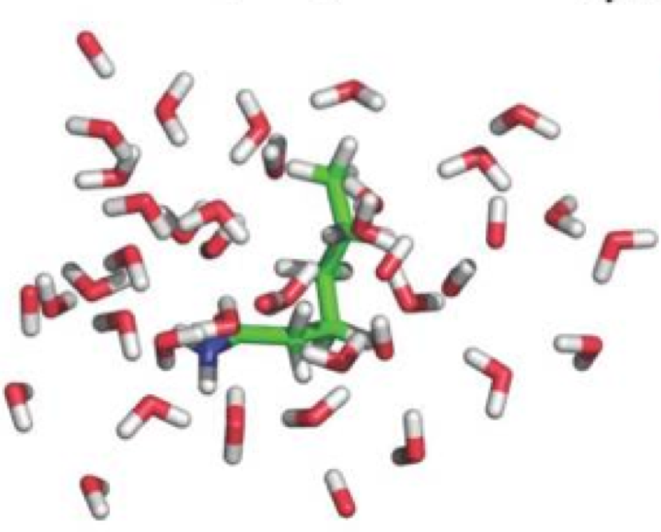
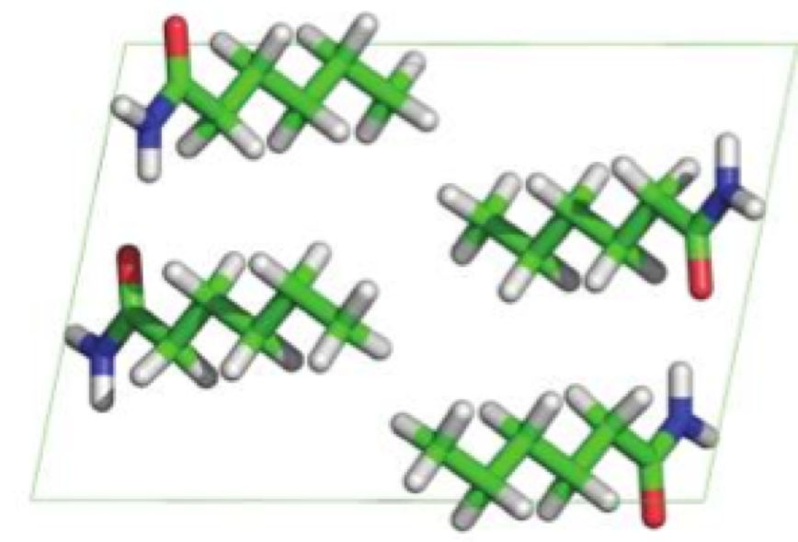
Chemical potential determines solubility
Polymorphs have
different chemical potential
From Ref [8]
From Ref [1]

Slide 58
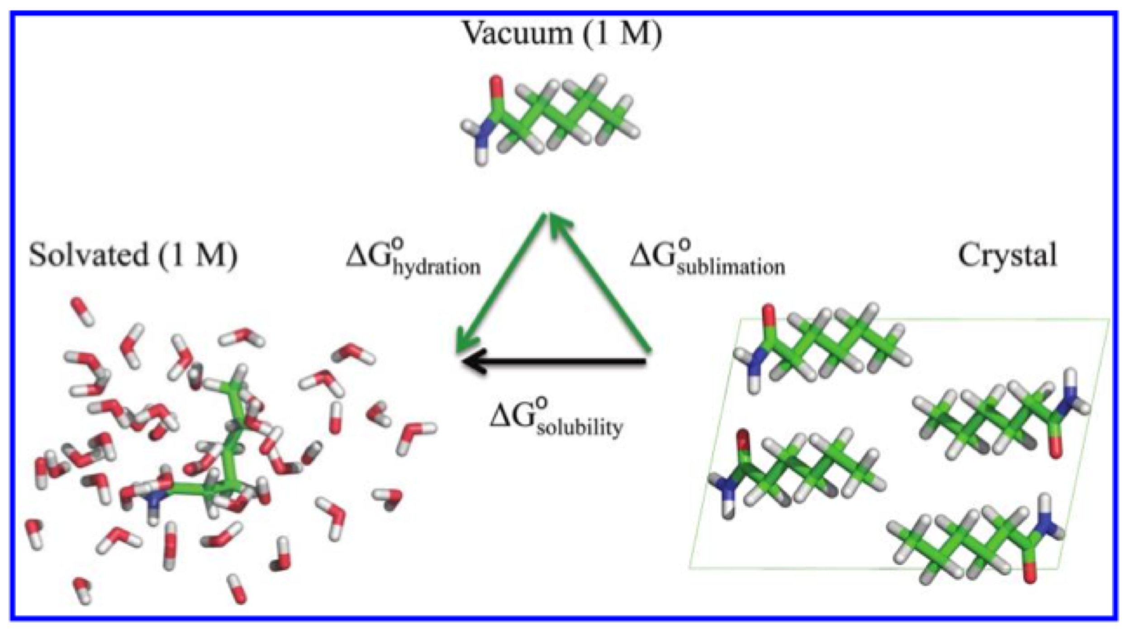
A thermodynamic cycle for solubility
From Ref [8]. Note that solubility ≠ solvation or hydration.
Hydration + sublimation free energies calculated with alchemical free energy methods.

Slide 59
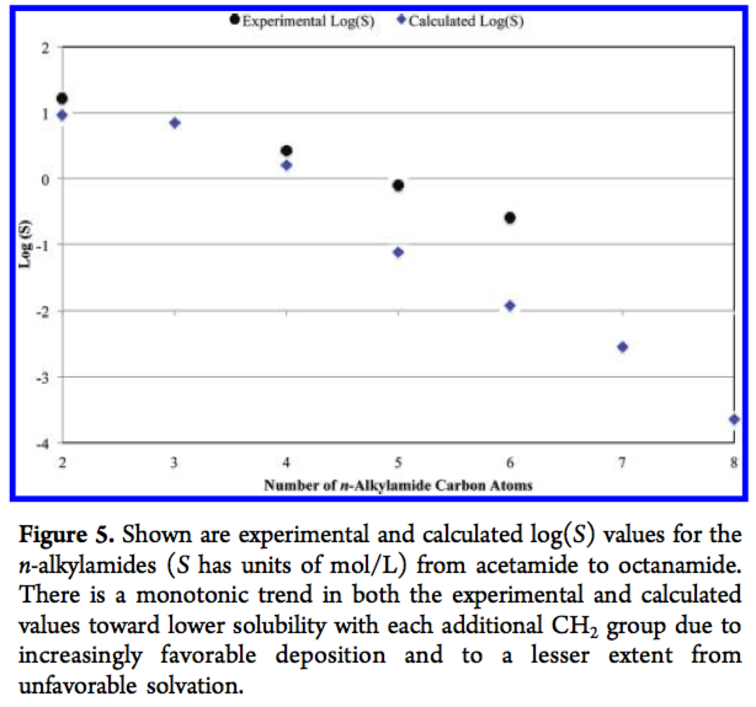
Results on an initial series appear promising without any tuning
From Ref [8]

Slide 60
References
[1] Many parts of today’s lecture were adapted from a lecture by David Mobley (https://github.com/MobleyLab/drug-computing/tree/master/uci-pharmsci/lectures/free_energy_basics) under the CC BY 4.0 license. The lecture is part of the Drug Discovery Computing Techniques course (PharmSci 175/275) at UC Irvine.
[2] Llinàs, A.; Glen, R. C.; Goodman, J. M. Solubility Challenge: Can You Predict Solubilities of 32 Molecules Using a Database of 100 Reliable Measurements? J. Chem. Inf. Model. 2008, 48 (7), 1289–1303. https://doi.org/10.1021/ci800058v.
[3] Hopfinger, A. J.; Esposito, E. X.; Llinàs, A.; Glen, R. C.; Goodman, J. M. Findings of the Challenge To Predict Aqueous Solubility. J. Chem. Inf. Model. 2009, 49 (1), 1–5. https://doi.org/10.1021/ci800436c.
[4] Prashad, M.; Sutton, P.; Wu, R.; Hu, B.; Vivelo, J.; Carosi, J.; Kapa, P.; Liang, J. Process Research and Development of a MTP Inhibitor: Another Case of Disappearing Polymorphs upon Scale-Up. Org. Process Res. Dev. 2010, 14 (4), 878–882. https://doi.org/10.1021/op100115u.

Slide 61
References
[5] Hewitt, M.; Cronin, M. T. D.; Enoch, S. J.; Madden, J. C.; Roberts, D. W.; Dearden, J. C. In Silico Prediction of Aqueous Solubility: The Solubility Challenge. J. Chem. Inf. Model. 2009, 49 (11), 2572–2587. https://doi.org/10.1021/ci900286s.
[6] Lusci, A.; Pollastri, G.; Baldi, P. Deep Architectures and Deep Learning in Chemoinformatics: The Prediction of Aqueous Solubility for Drug-Like Molecules. J. Chem. Inf. Model. 2013, 53 (7), 1563–1575. https://doi.org/10.1021/ci400187y.
[7] Tang, B.; Kramer, S. T.; Fang, M.; Qiu, Y.; Wu, Z.; Xu, D. A Self-Attention Based Message Passing Neural Network for Predicting Molecular Lipophilicity and Aqueous Solubility. J Cheminform 2020, 12 (1), 15. https://doi.org/10.1186/s13321-020-0414-z. Figures adapted under the CC BY 4.0 license.
[8] Schnieders, M. J.; Baltrusaitis, J.; Shi, Y.; Chattree, G.; Zheng, L.; Yang, W.; Ren, P. The Structure, Thermodynamics, and Solubility of Organic Crystals from Simulation with a Polarizable Force Field. J. Chem. Theory Comput. 2012, 8 (5), 1721–1736. https://doi.org/10.1021/ct300035u.

